Slide 1


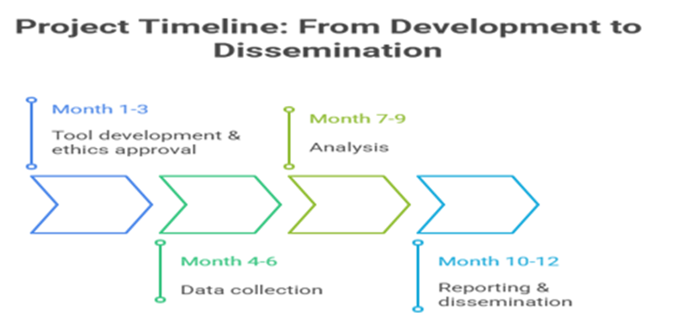

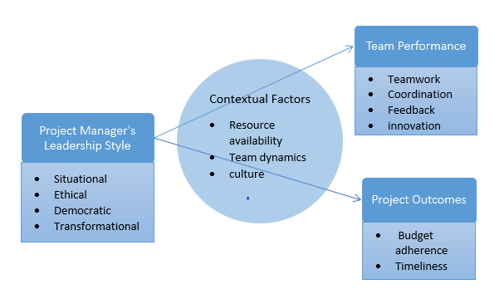
Investigating the Impact of Project Managers’ Leadership Style on Team Performance and Project Outcomes
Objectives
Proposed Research Design and Methodology Approach
References
  Examine how ethical, situational, and democratic leadership styles influence team performance and project outcomes within Dubai Municipality.
  Assess the effect of project managers’ leadership styles on budget management and the timely completion of projects in Dubai Municipality.
  Compare the effectiveness of transformational leadership in fast-track plans and democratic leadership in long-span projects within Dubai Municipality.
  Explore how contextual factors such as team dynamics, organisational culture, and resource availability shape the relationship between team performance, project outcomes, and leadership style.
  Recommend strategies to enhance leadership practices within Dubai Municipality, aiming to improve the success of the project and team performance.
  Alblooshi, M., Shamsuzzaman, M. and Haridy, S., 2021. The relationship between leadership styles and organisational innovation: A systematic literature review and narrative synthesis. European Journal of Innovation Management, 24(2), pp.338-370.
  Baig, S.A., Iqbal, S., Abrar, M., Baig, I.A., Amjad, F., Zia-ur-Rehman, M. and Awan, M.U., 2021. Impact of leadership styles on employees’ performance with moderating role of positive psychological capital. Total Quality Management & Business Excellence, 32(9-10), pp.1085-1105.
  Bhatti, S.H., Kiyani, S.K., Dust, S.B. and Zakariya, R., 2021. The impact of ethical leadership on project success: the mediating role of trust and knowledge sharing. International Journal of Managing Projects in Business, 14(4), pp.982-998.
  Braun, V. and Clarke, V., 2019. Reflecting on reflexive thematic analysis. Qualitative research in sport, exercise and health, 11(4), pp.589-597.
  Government of Dubai, 2022. Dubai Municipality to showcase most innovative projects at GITEX Global 2022. Available at: The Research Model is given in Figure 1
  Sampling: Purposive sampling of 20–25 experienced project managers and team leaders (≥3 years relevant experience).
  Data Collection: Semi-structured interviews conducted via Microsoft Teams; recorded, transcribed, and anonymised.
  Data Analysis: Thematic analysis (Braun & Clarke, 2019) to identify patterns in leadership behaviours, contextual influences, and project outcomes.
  Ethics: Informed consent, voluntary participation, GDPR-compliant data storage, pseudo-anonymisation to protect identities.
  Madi Odeh, R.B., Obeidat, B.Y., Jaradat, M.O., Masa'deh, R.E. and Alshurideh, M.T., 2023. The transformational leadership role in achieving organizational resilience through adaptive cultures: the case of Dubai service sector. International Journal of Productivity and Performance Management, 72(2), pp.440-468.
  Tang, K.N., 2019. Leadership styles and organisational effectiveness. Leadership and change management, pp.11-25.
  Sampling: Purposive sampling of 20–25 experienced project managers and team leaders (≥3 years relevant experience).
  Data Collection: Semi-structured interviews conducted via Microsoft Teams; recorded, transcribed, and anonymised.
  Data Analysis: Thematic analysis (Braun & Clarke, 2019) to identify patterns in leadership behaviours, contextual influences, and project outcomes.
  Ethics: Informed consent, voluntary participation, GDPR-compliant data storage, pseudo-anonymisation to protect identities.
Intended Contribution to Knowledge and Practice To Knowledge
  Extends understanding of leadership–performance linkages in a public sector, Middle Eastern context.
  Integrates sustainability principles into leadership evaluation frameworks for project management.
Source: (Author)
Background and Rationale of the Study
Research Aims
To examine how leadership styles adopted by project managers influence team performance and sustainable project outcomes in Dubai Municipality.
Theoretical Framework
Effective leadership is considered as a critical driver for the success of a project, yet its role in achieving sustainable outcomes in UAE public sector projects remains underexplored. Dubai Municipality manages complex, multi-disciplinary projects where leadership agility is essential to navigate innovation, uncertainty, and diverse teams (Government of Dubai, 2022). Leadership behaviours influence not only short-term outputs but also long-term value creation, efficient resource use, and stakeholder satisfaction (Alblooshi et al., 2021; Baig et al., 2021). This research addresses a literature gap by focusing on the lived experiences of project managers and team members in a governmental context, providing insights into leadership’s direct impact on performance and sustainable outcomes.
The Research Model is given in Figure 1
The study draws upon established leadership and project management theories:
  Transformational Leadership – inspires innovation and long-term commitment (Madi Odeh et al., 2021).
  Democratic Leadership – fosters participation and shared decision-making (Tang, 2019).
  Ethical Leadership – embeds integrity and stakeholder trust (Bhatti et al., 2021).
  Situational Leadership – adapts style to context and team maturity. These are examined within the sustainability-oriented project leadership perspective, integrating concepts from organisational behaviour and sustainable project management (Bhatti et al., 2021).
Figure 1: Research Model
Source: (Author)

